Slide 1
Order Of Execution, Apex Transactions, and Governor Limits
Trailhead Live: https://sfdc.co/etOOE

Slide 2
Forward Looking Statements
Safe harbor statement under the Private Securities Litigation Reform Act of 1995:
This document and other items we publish, including through social media outlets, may contain forward-looking statements, the achievement or success of which involves risks, uncertainties, and assumptions. If any such risks or uncertainties materialize or if any of the assumptions proves incorrect, the results of salesforce.com, inc. could differ materially from the results expressed or implied by the forward-looking statements we make.
The risks and uncertainties referred to above include – but are not limited to – risks associated with possible fluctuations in our financial and operating results; our rate of growth and anticipated revenue run rate, including our ability to convert deferred revenue and unbilled deferred revenue into revenue and, as appropriate, cash flow, and our ability to grow deferred revenue and unbilled deferred revenue; errors, interruptions or delays in our service or Web hosting; breaches of our security measures; the financial impact of any previous and future acquisitions; the nature of our business model; our ability to continue to release, and gain customer acceptance of, new and improved versions of our service; successful customer deployment and utilization of our existing and future services; changes in our sales cycle; competition; various financial aspects of our subscription model; unexpected increases in attrition or decreases in new business; our ability to realize benefits from strategic partnerships; reliance on third-party computer hardware and software; the emerging markets in which we operate; unique aspects of entering or expanding in international markets; our ability to hire, retain and motivate employees and manage our growth; changes in our customer base; technological developments; regulatory developments; litigation related to intellectual property and other matters, and any related claims, negotiations and settlements; unanticipated changes in our effective tax rate; factors affecting our outstanding convertible notes and credit facility; fluctuations in the number of shares we have outstanding and the price of such shares; foreign currency exchange rates; collection of receivables; interest rates; factors affecting our deferred tax assets and ability to value and utilize them, including the timing of achieving profitability on a pre-tax basis; the potential negative impact of indirect tax exposure; the risks and expenses associated with our real estate and office facilities space; and general developments in the economy, financial markets, and credit markets.
Further information on these and other factors that could affect the financial results of salesforce.com, inc. is included in the reports on Forms 10-K, 10-Q and 8-K and in other filings we make with the Securities and Exchange Commission from time to time, including our most recent Form 10-K. These documents are available on the SEC Filings section of the Investor Information section of our website at www.salesforce.com/investor.
Any unreleased services or features referenced in this or other presentations, press releases or public statements are not currently available and may not be delivered on time or at all. Customers who purchase our services should make their purchase decisions based upon features that are currently available.

Slide 3
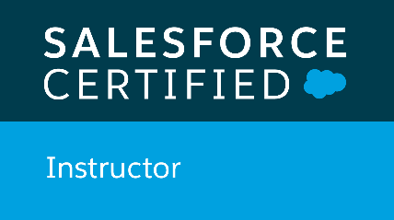
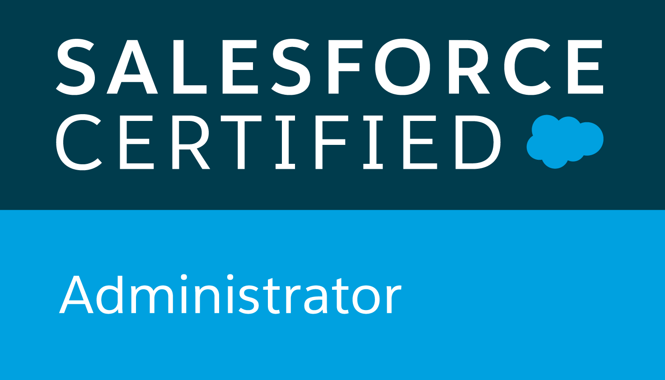
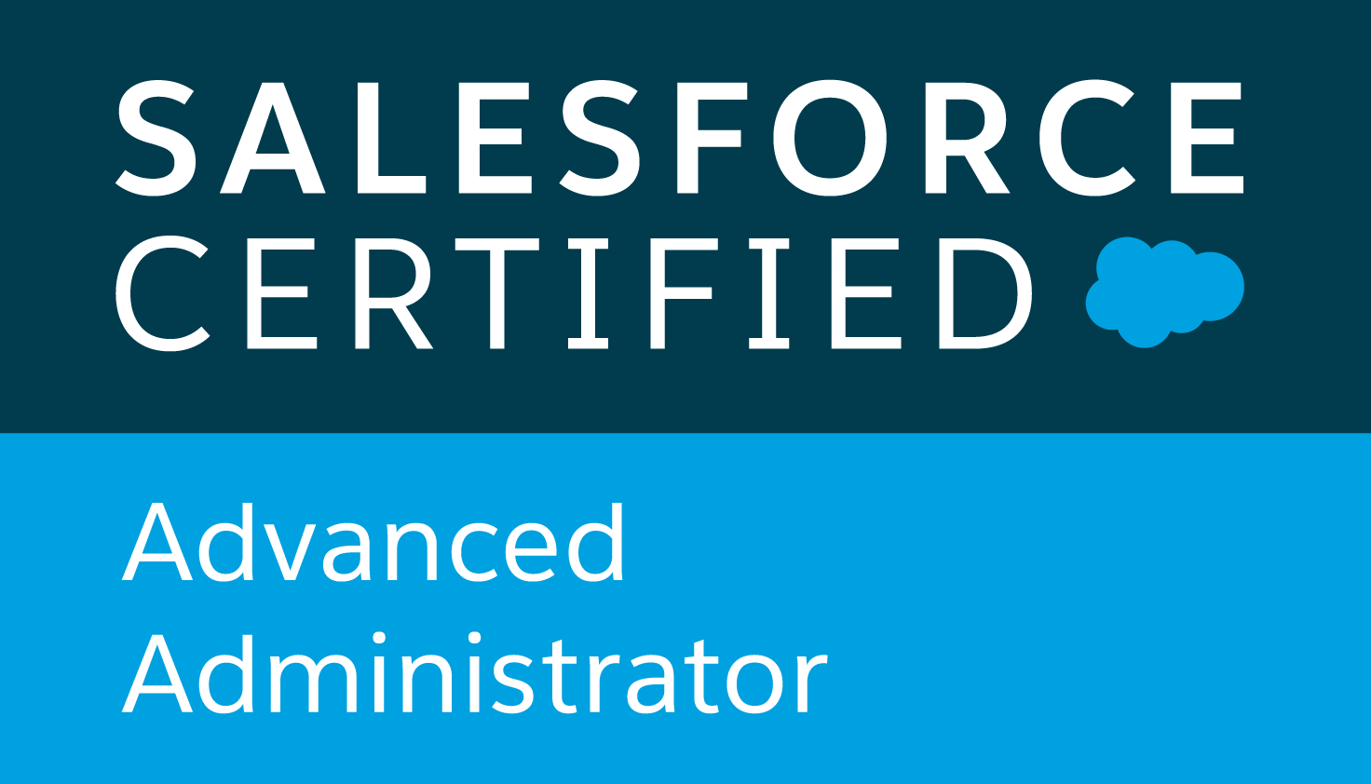
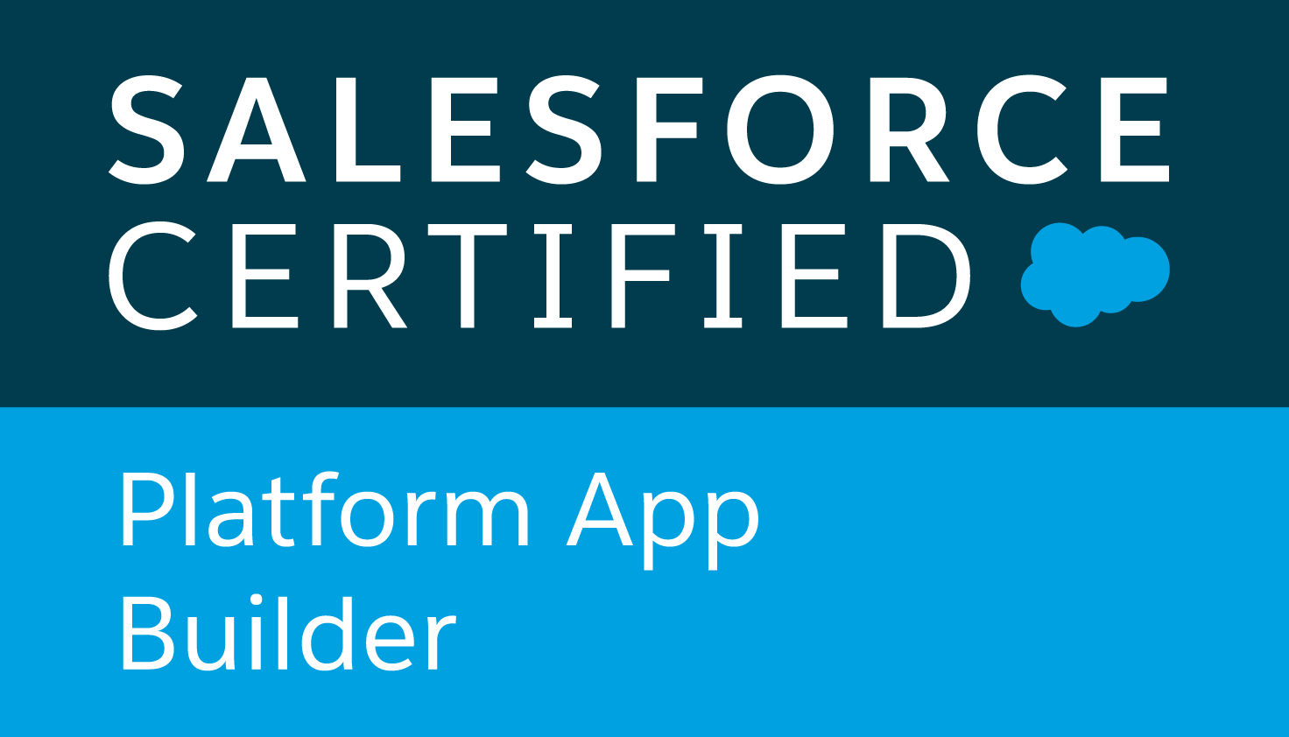
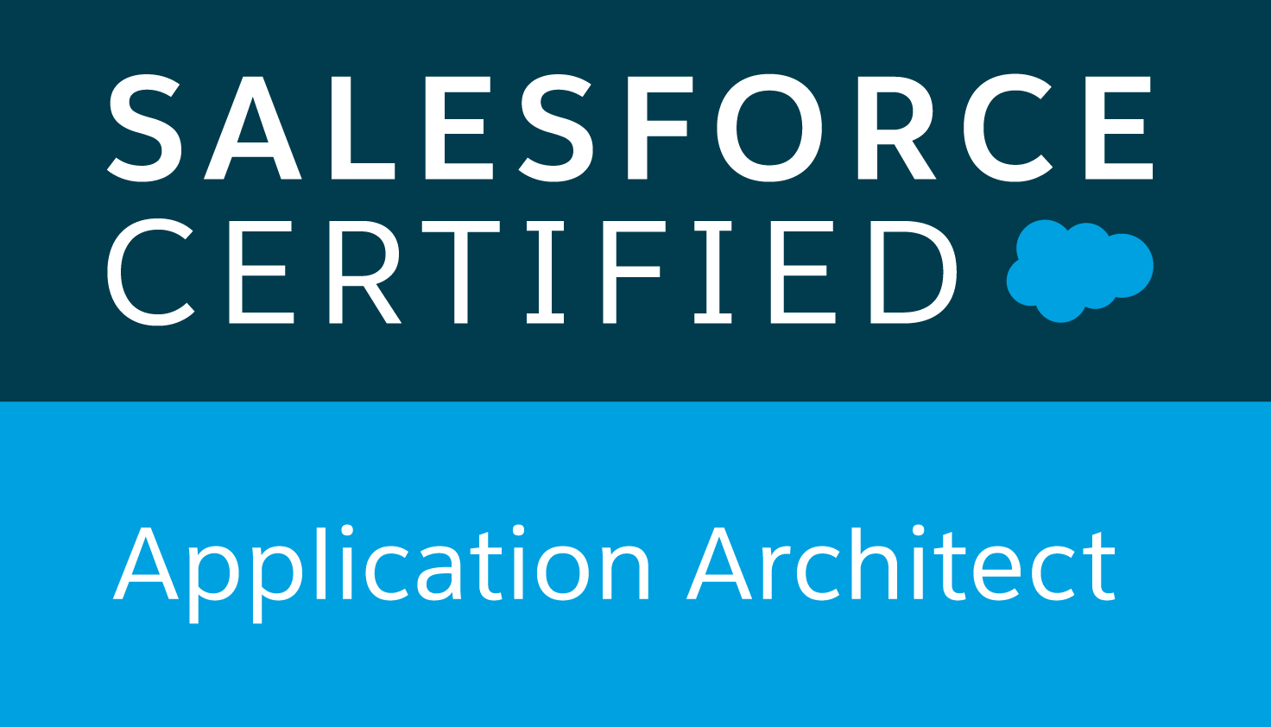
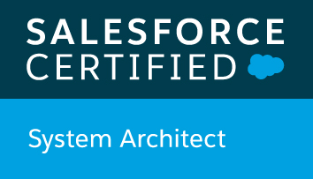
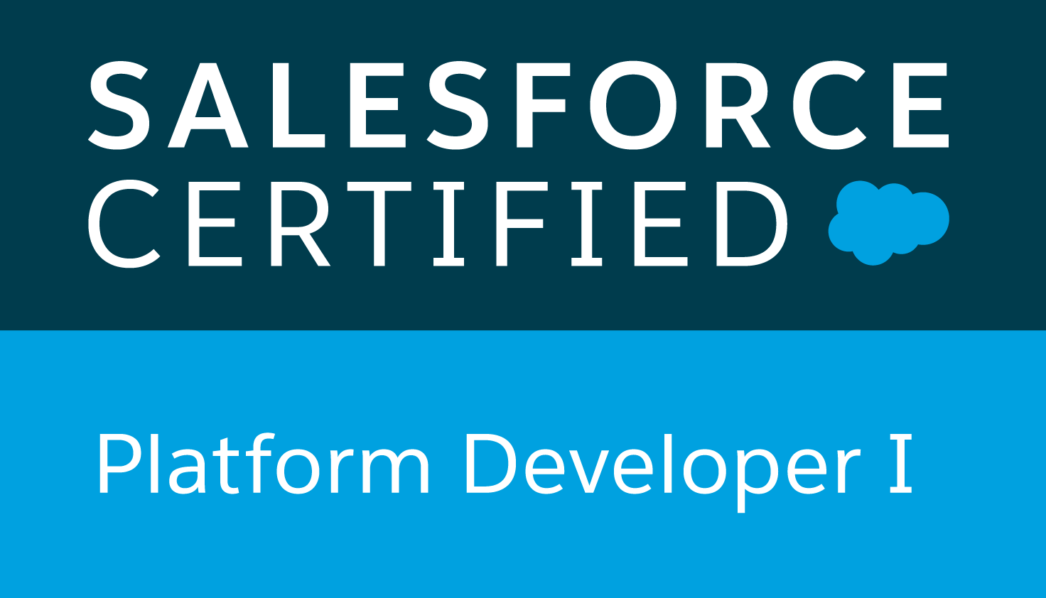
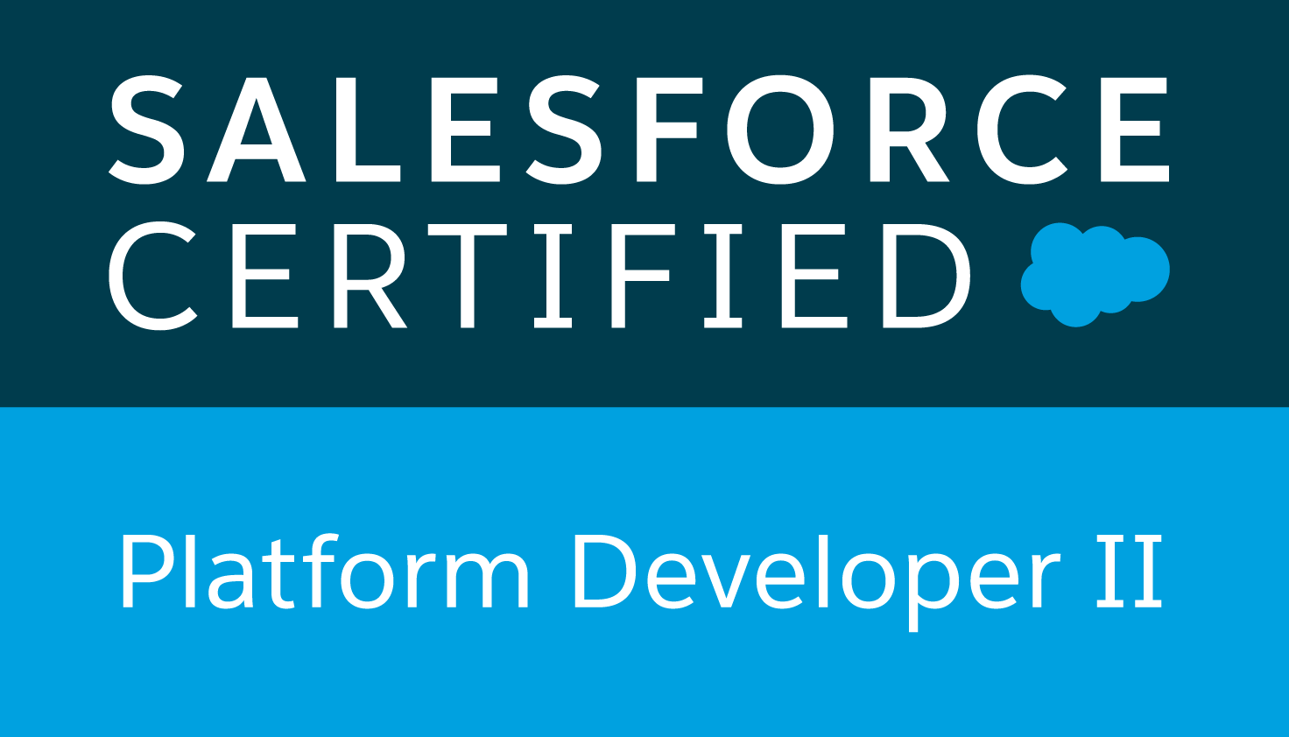

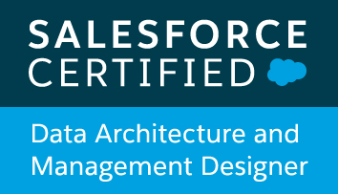
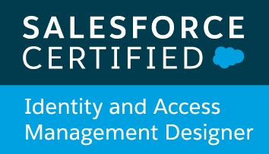
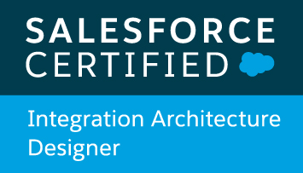


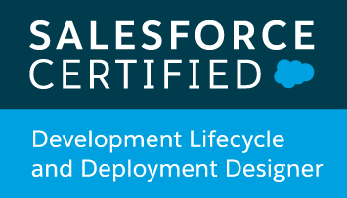
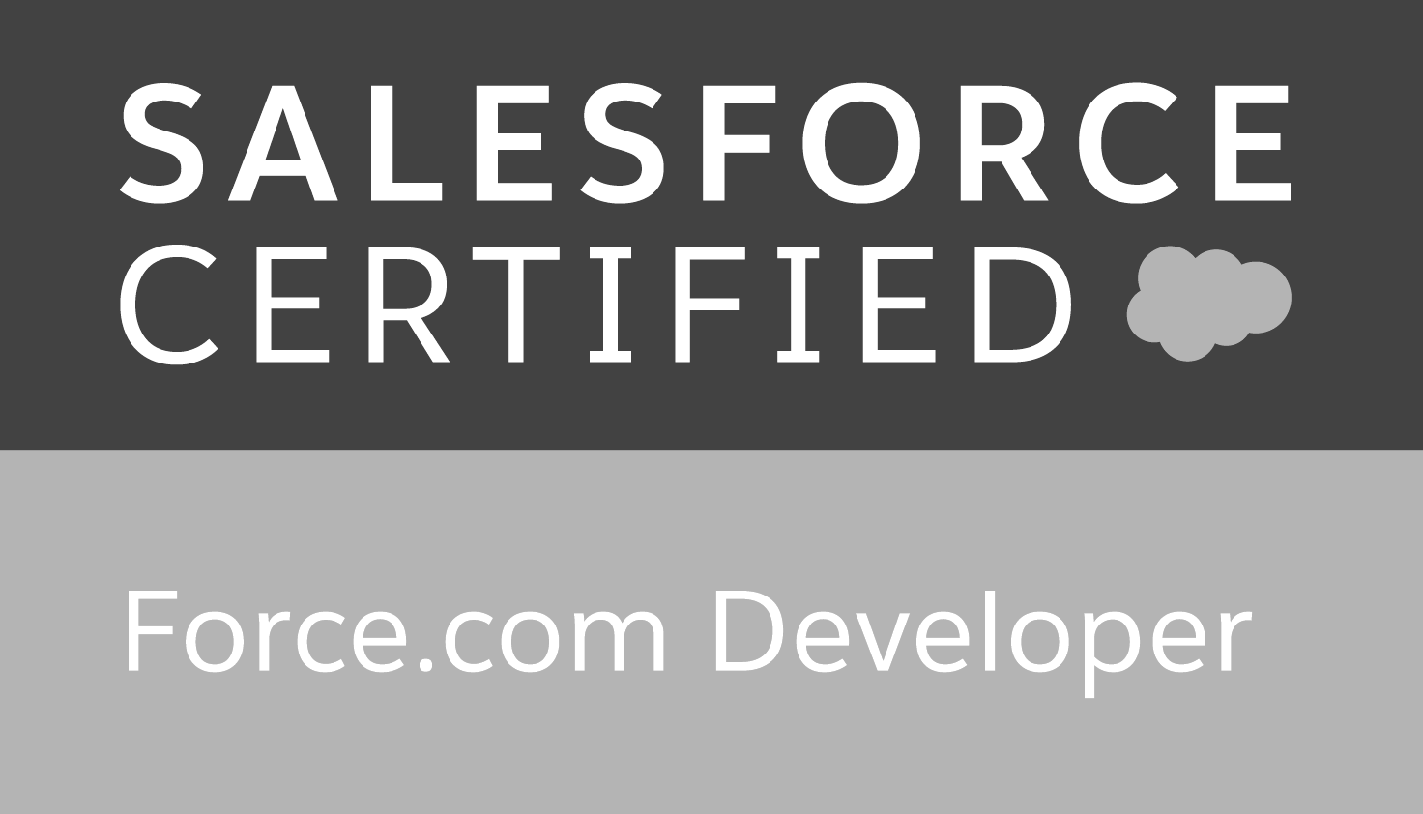
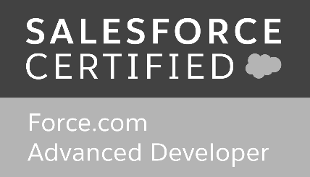

Andrés Pérez
@ELTOROIT Global Master Technical Instructor

Slide 4
Order Of Execution
Field Updates
Apex Transactions
Governor Limits
Q & A
Agenda
Flow GL + Apex GL + Package GL

Slide 5
Order Of Execution

Slide 6
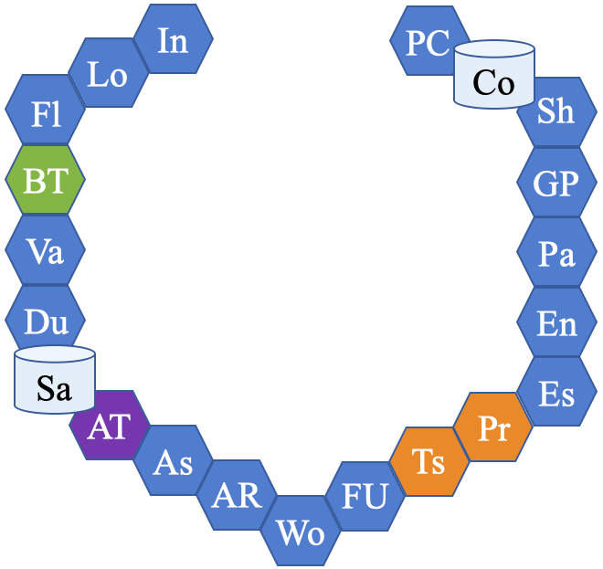
Order Of Execution
Series of steps performed when saving a record
Saving = insert, update, or upsert
The number of steps have changed between releases
Spring ‘20 has 21 steps
Source for most issues by developers, app builders and administrators
Covered in multiple Salesforce certification exams

Slide 7
Order Of Execution: #1 Initialize
If insert => Initialize a new record
If Update => Load original record
This will allow you to have the record in Trigger.old if you are using Apex, or the functions priorValue() and isChanged() when working declaratively

Slide 8
Order Of Execution: #2 Load
Loads the new record field values from the request and overwrites the old values
For Apex, this is needed for Trigger.new
Did the request came from the user Interface (page layout)?
Yes, run system validation rules
Compliance with layout-specific rules
Required values at the layout level and field-definition level
Valid field formats
Maximum field length
No, validate foreign keys
The foreign key can’t refer to itself

Slide 9
Order Of Execution: #3 Flows
Executes flows that make before-save updates.
Spring ‘20
Notes:
https://jenwlee.com/2020/02/07/run-flows-on-record-changes-before-save-updates/

Slide 10
Order Of Execution: #4 Before Triggers
*
“Executes all before triggers”
Are you inserting? Executes all before insert triggers
Are you updating? Executes all before update triggers
But, you should not have multiple triggers on the same object/event
The order is not-deterministic!
Remember a before trigger purpose is to make changes to the current records…

Slide 11
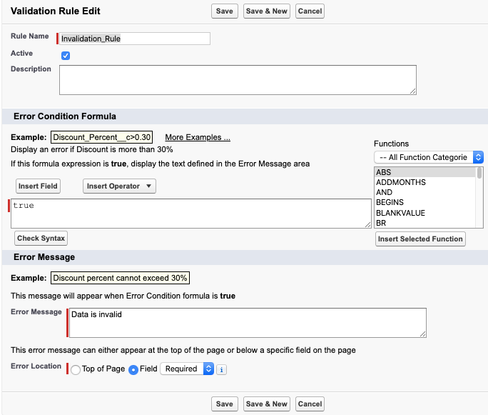
Order Of Execution: #5 Validation
Runs system validation steps
Again, because before trigger could have changed data
Does not run the page layout rules
Runs for first time every user-defined validation rules
“Invalidation rules”
If true, the data is invalid!

Slide 12
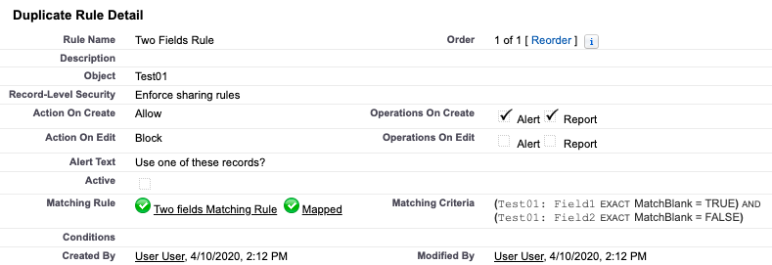
Order Of Execution: #6 Duplicates
Executes duplicate rules
If blocking duplicates, the record is not saved and no further steps are taken.
Notes:
Only for Account, Contact, Individual, Lead, Custom Objects

Slide 13
Order Of Execution: #7 Save
Saves the record to the database
It doesn't commit yet.
Assigns values to these fields
ID
CreatedDate
CreatedById
LastModifiedDate
LastModifiedById
SystemModStamp

Slide 14
Order Of Execution: #8 After Triggers
*
“Executes all after triggers”
Are you inserting? Executes all after insert triggers
Are you updating? Executes all after update triggers
But, you should not have multiple triggers on the same object/event
The order is not-deterministic!
Remember an after trigger usually modifies other records
The entire Order Of Execution is executed for those records.
Commit will not happen here!
X

Slide 15
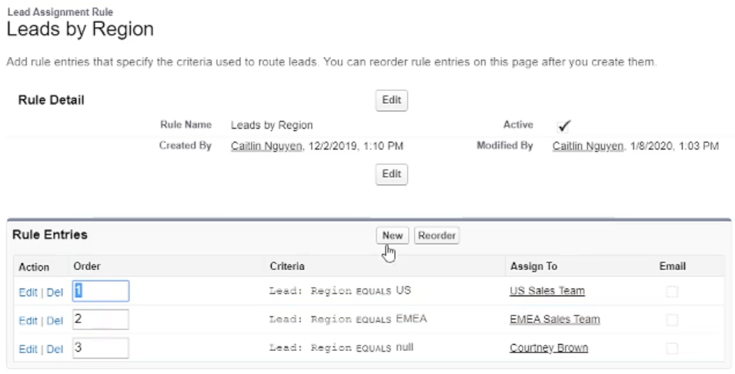
Order Of Execution: #9 Assignment
Executes assignment rules
Sets the owner (user or queue) for cases or leads based on custom rules
Notes:
Assignment rules must be checked to be executed, by default they are not. This can be defaulted on the page layout’s properties.

Slide 16
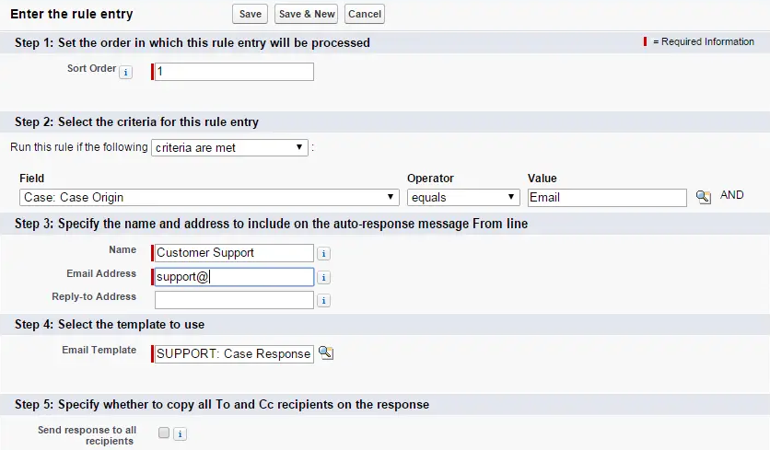
Order Of Execution: #10 Auto-Response
Executes auto-response rules for cases and leads
Automatically send emails in response to events
Case must be created by customer (ex: web-to-lead, community, …)
Emails are scheduled here
Emails are sent at the end of the Apex Transaction
Notes:
https://help.salesforce.com/articleView?id=creating_auto-response_rules.htm&type=5
Create auto-response rules for leads captured through a Web-to-Lead form and for cases submitted through a:
Self-Service portal
Customer Portal
Web-to-Case form
Email-to-Case message
On-Demand Email-to-Case message

Slide 17
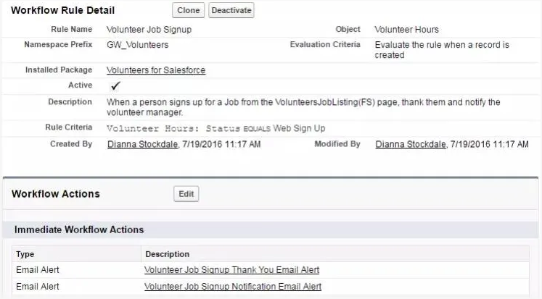
Order Of Execution: #11 Workflows
*
Executes workflow rules
They can perform these actions:
Email Alerts
Outbound Messages
Create Tasks
Field Updates

Slide 18
Order Of Execution: #12 Field Updates
If the Workflow field updates make changes to the record
Updates the record again
But… DOES NOT execute entire Order Of Execution for current record
So, what happens?

Slide 19
Order Of Execution: #13 Triggers
*
If the record was changed with a Workflow Field Update, it executes
Before update triggers
Standard system validations
DO NOT execute custom validations
Saves the record again
After update triggers
Note: It will not execute
Before update flows
Custom validation rules
Duplicate rules
Processes
Escalation rules
Standard system validations
Custom validations are not run!
Before update trigger(s)
After update trigger(s)
Save, not commit
X
BT
Sa
AT

Slide 20
Order Of Execution: #14 Processes
*
Executes processes
If they make changes to the records…
Most of the save order of execution is executed
Entire Save Order Of Execution when
DML to other records
DML from launched flows
Commit will not happen here!
X

Slide 21
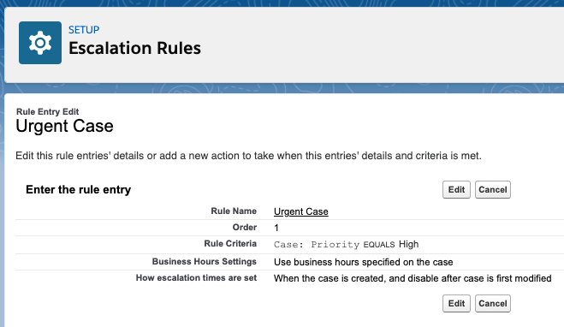
Order Of Execution: #15 Escalation
Executes escalation rules
Assigns a case to a person or a queue
Notifies a person that a case needs attention

Slide 22
Order Of Execution: #16 Entitlements
Executes entitlement rules
Helps manage your cases SLAs, and your Work Orders
Notes:
More research needed here ;-)

Slide 23
Order Of Execution: #17 Parent
*
Update parent records
If parent record contains roll-up summary field that needs to be changed
If a cross-object workflow field update made changes to the master record
Execute entire Order Of Execution for parent record
Commit will not happen here!
X

Slide 24
Order Of Execution: #18 Grand-Parent
*
Update grand-parent records
If grand-parent record contains roll-up summary field that needs to be changed because the parent record changed
If a cross-object workflow field update on the parent made changes to the grand-parent record
Execute entire Order Of Execution for grand-parent record
except for commit
Commit will not happen here!
X
X

Slide 25
Order Of Execution: #19 Sharing
Executes Criteria Based Sharing evaluation
Updates the sharing records
These records do not have Order Of Execution!

Slide 26
Order Of Execution: #20 Commit
*
Commits all DML operations to the database.
Only if this is the end of the Transaction!

Slide 27
Order Of Execution: #21 Post-Commit
*
Executes post-commit logic
Sending emails
Execute asynchronous Apex (@future, queueable)
Outbound Messages
Only if this is the end of the Transaction!

Slide 28
A Picture Is Worth 1000 Words ☺

Slide 29
Field Updates

Slide 30
Update Triggers Firing Multiple Times?
*
How many times can a trigger fire?
That’s a hard question to answer…
I have had the same before update trigger firing 100 times!
Why can a before update trigger fire?
You are updating a record
You are inserting a record
But you have declarative field updates!
Workflow field updates
Process field updates
Notes:
WF
Re-evaluate Workflow Rules after Field Change

Slide 31
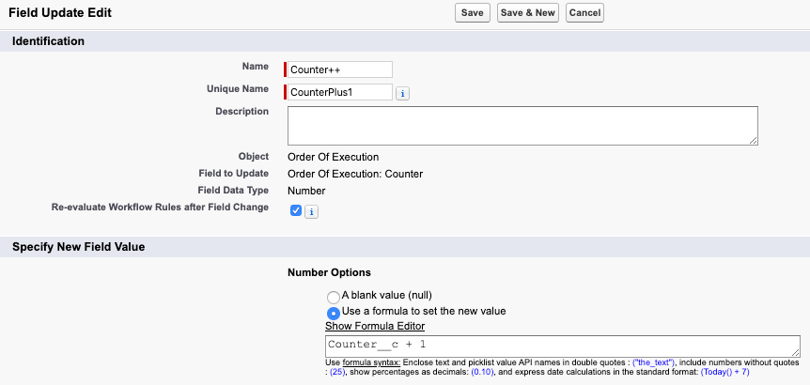
Re-evaluate Workflows
Notes:
WF
Re-evaluate Workflow Rules after Field Change

Slide 32
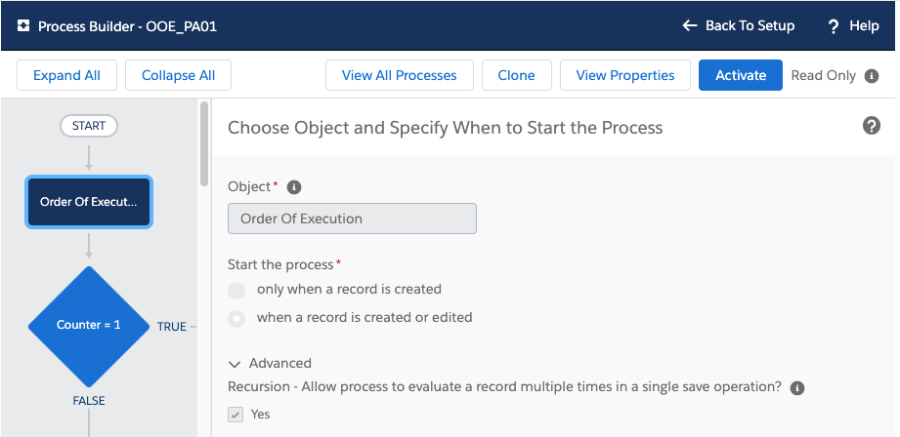
Recursive Processes Field Updates
Notes:
WF
Re-evaluate Workflow Rules after Field Change

Slide 33
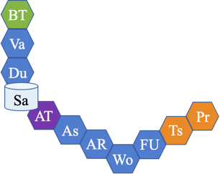

Save Order Of Execution With Field Updates
*
Find all workflows which can be fired
Meet criteria
Workflow has not been executed
Execute all the workflows
Execute triggers*
Find one process which can be fired
Meet criteria
Criteria has not been executed
Execute that single process
Execute Save Order*
Go back to step 4 (Until no more processes found)
Go back to step 1 (up to 5 additional times)
Go back up to 5 times
Until no more processes found
Notes:
WF
Re-evaluate Workflow Rules after Field Change

Slide 34
Demo

Slide 35
Apex Transaction

Slide 36
What’s An Apex Transaction?
*
“Represents a set of operations that are executed as a single unit.”
You can’t have ½ Apex Transaction
But it could terminates prematurely.
Exceptions
Governor Limits
Every time Salesforce is “hit”
User saves a record on a page layout
API call is made to Salesforce to load or retrieve data
Execute Anonymous
Asynchronous Apex (@Future, Queueable, Batchable, Schedulable, …)
Notes:
WF
Re-evaluate Workflow Rules after Field Change

Slide 37
*
Single Apex Transaction - Code Sample
Create
Account
Insert
Account
Create
Contact
Insert
Contact
System.Debug()
PC
Co
X
X
Commit and post-commit will happen here!
Suppose we have this code
Execute Anonymous
Apex Webservice
Future Method
Commit will not happen here!
Commit will not happen here!
Account newAccount = new Account(Name = 'Acme');
insert newAccount;
Contact newContact = new Contact(LastName = 'Manning', AccountId = newAccount.Id);
insert newContact;
System.debug('About to commit...');

Slide 38
Why Is This So important?

Slide 39
Why Is This So Important?
*
App Builder
You can break code with clicks!
Which tool to use?
Developer
Governor Limits
Changing the record owner…
Assignment rule
Workflow field update
Process field update
Apply to the entire Apex Transaction!

Slide 40
Q&A

Slide 41
PC
In
PC
Co
Lo
Co
Fl
Sh
BT
GP
Va
Pa
Du
En
Sa
Es
AT
Pr
As
Ts
AR
FU
Wo
Notes:
Parts

Slide 42
Notes:
Image

